Slide 1
Nutrition Fact for McDonald’s Menu
Rinaldi Sirait
Rizqi Prima
Rama W P
Fresh Graduate Academy
Data Science
Digital Talent Scholarship 2020

Slide 2
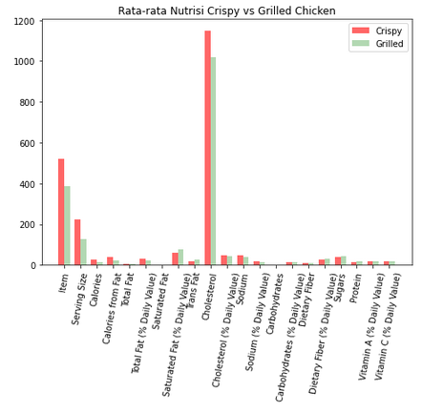
2. How many do beverages, like soda or cofe, contribute to the overall caloric intake?
3. Does ordered grilled chicken instead of crispy increase a sandwich’s nutritional value ?
1. How many calories does average McDonald’s value meal contain?
368.26
3.21 %

Slide 3
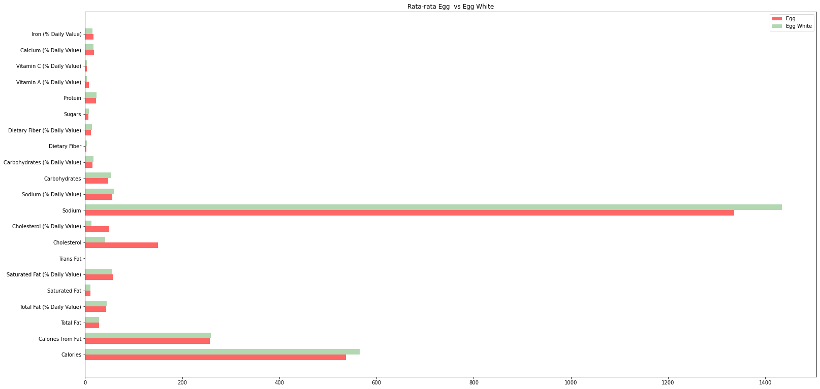
4. What about ordering eggwhites instead of whole eggs?

Slide 4
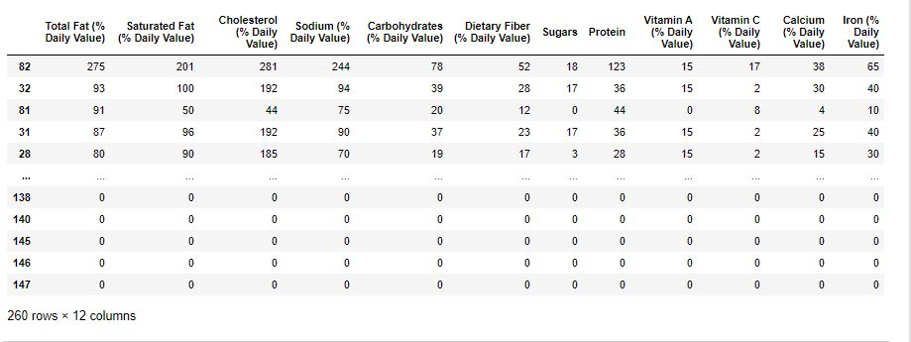
5. What is the least number of items could you order from menu to meet one day’s nutritional requirements?

Slide 5
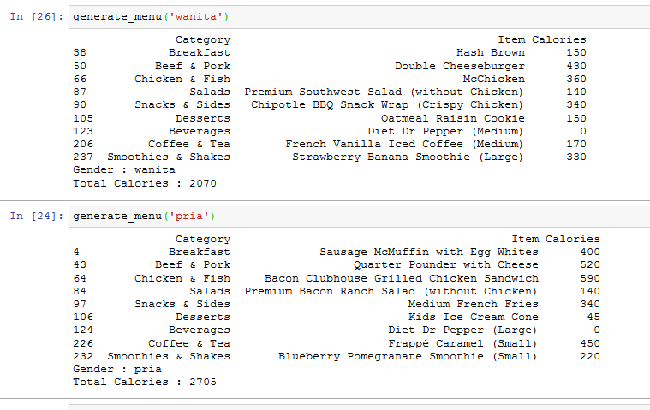

5. What is the least number of items could you order from menu to meet one day’s nutritional requirements?
Idealnya, wanita dewasa memerlukan antara 1.600 hingga 2.400 kalori per hari. Sedangkan untuk pria dewasa, 2.000 – 3.000 kalori per hari.
Sumber : https://www.gooddoctor.co.id/tips-kesehatan/nutrisi/yuk-cari-tahu-berapa-kebutuhan-kalori-per-hari-yang-diperlukan-tubuh/

